Slide 1

User-generated music sharing system - a website
Final Group Project
Group Name: Spring Flowers
Alex Shen; Fei Yan; Junzhi Qian; Rong Zhou; Sunhao Shen; Xinyi Zhu; Yazhou Ye; Yuxin Duan; Zehui Wang; Shunzhe Xie

Slide 2
Contents
Motivation & Goal
Problem Statement
Tactics
Implementation

Slide 3
Group Assignment
Design the web page, design this online music system. Using the c#, and asp to design the basic page.
  FEI YAN, RONG ZHOU, XINYI ZHU, YUXING DUAN
Database Development
  ALEX SHEN, JUNZHI QIAN, ZEHUI WANG
Network Platform Development
  SHUNZHE XIE, SUNHAO SHEN,YAZHOU YE

Slide 4

Motivation & Goal

Slide 5
Motivation
User-generated content sharing has been popular for years
The rising of the “we-media” concept
It would keep on developing and transforming exiting business models

Slide 6
Goal
Develop the paradigms of developing this user-generated content sharing system by designing and implementation a user-generated music sharing system in the form of a website.

Slide 7

Problem Statement

Slide 8
Problem and Solution Space Domain
Problem space domain
  Online user-generated music sharing website
Solution space domain
  We map regions of the problem space (domains) into domain-specific software architectures (DSSAs)

Slide 9

Tactics

Slide 10
Tactics
Create the domain model
Create the requirements
Create your reference architecture
Create your component library
Create your domain dictionaryusually the last step
Create the information model with
  Context diagram
  Entity relationship diagram
  Semantic network
  Class object diagram

Slide 11
Tactics
Create the feature model with
  Feature relationship diagram
  Use case diagram: functional requirement (able to log in…)
  Representation diagram
Create the operational model with
  Data flow diagram
  Control flow diagram
  State transition diagram

Slide 12
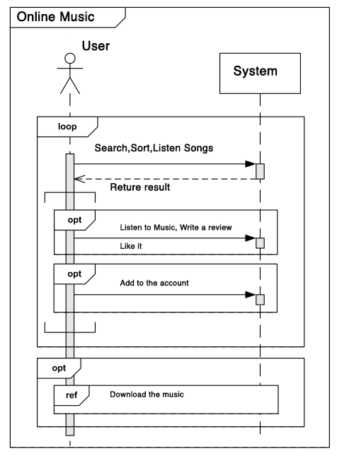
Context Diagram

Slide 13
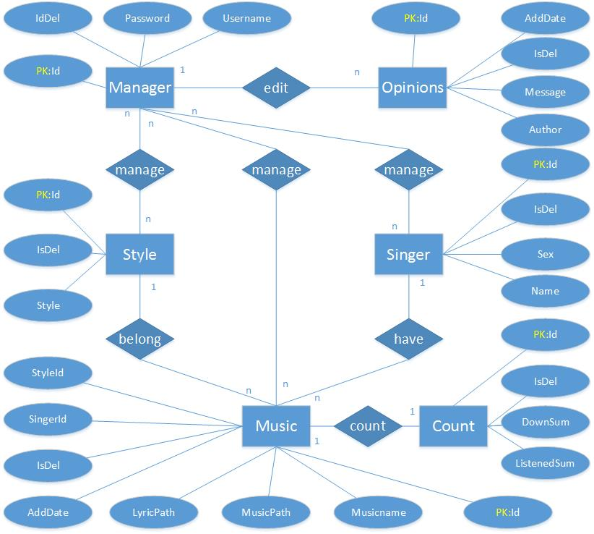
Entity Relationship

Slide 14
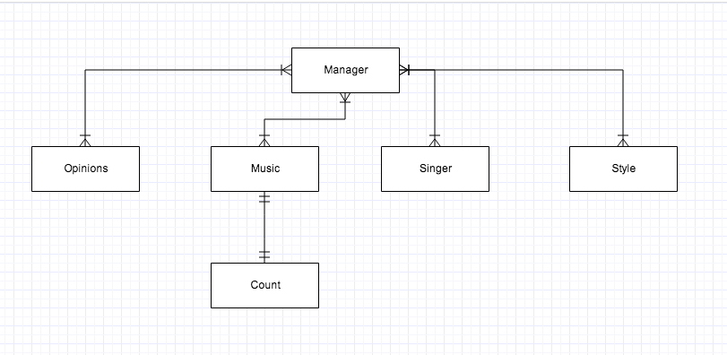
Semantic Network

Slide 15
Object Diagram
Object | Attributes | Operations
Manager | Username Password Permission | Manage the platform
Opinion | Review Content Username Attitude | User review: save Display, Review, Analyze
Music | SongName, Style | Listen
Singer | Singer Name | Rank
Style | Style Name
Count | Listen Sum, Download Sum | User Likes it. Display Save

Slide 16
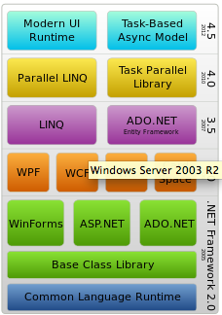
Frame Stack

Slide 17
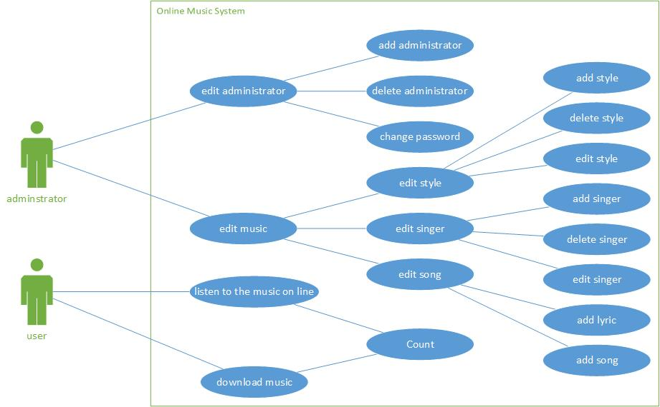
User Case

Slide 18
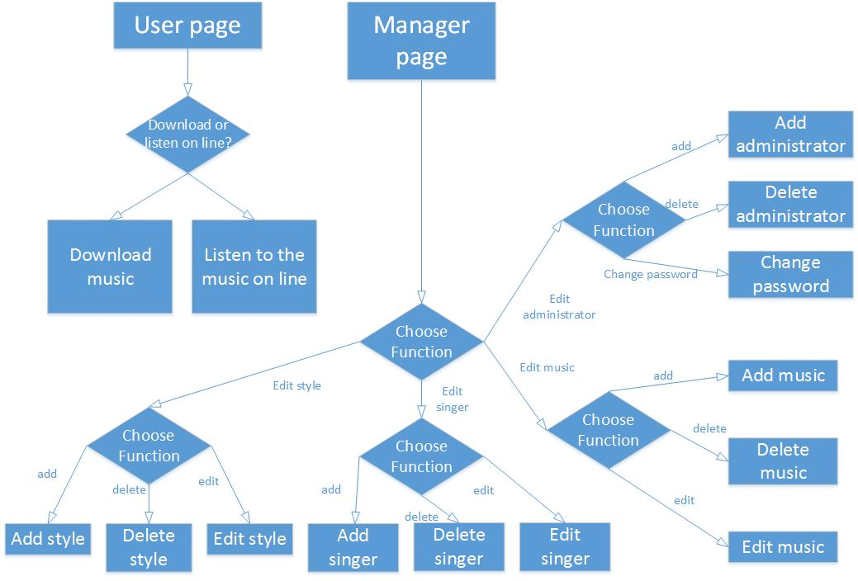
Control Flow

Slide 19
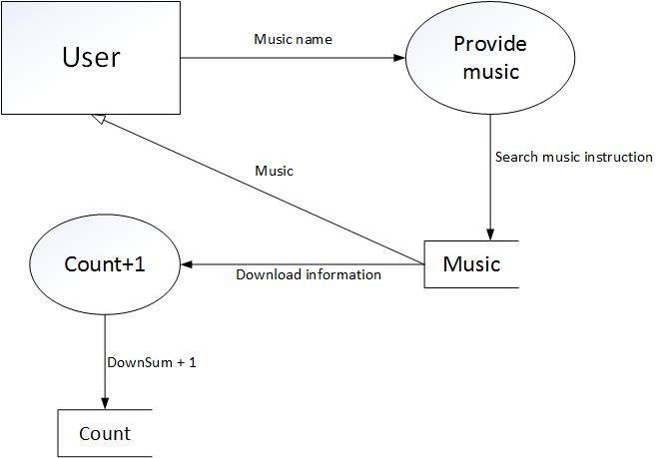
Data Flow - Download

Slide 20
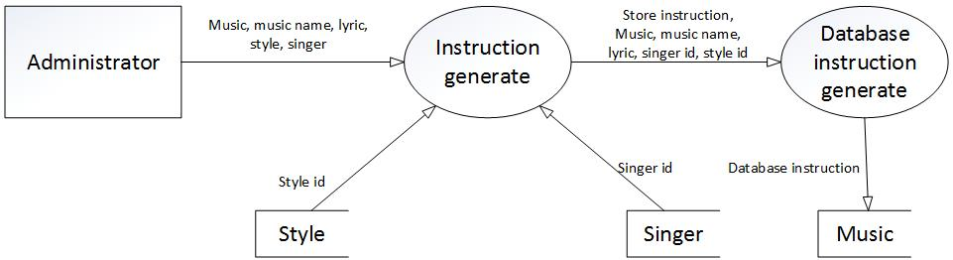
Data Flow - Store

Slide 21
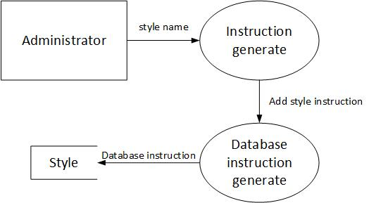
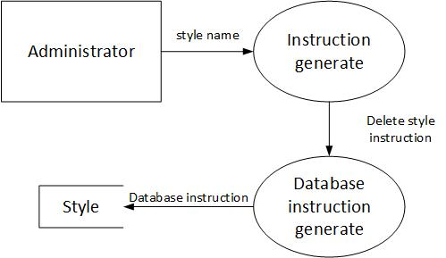
Data Flow - Add and Delete Style

Slide 22
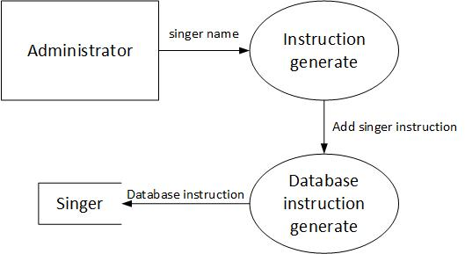
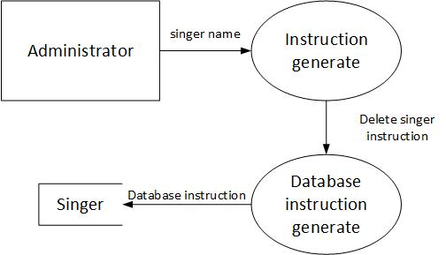
Data Flow - Add and Delete Singer

Slide 23
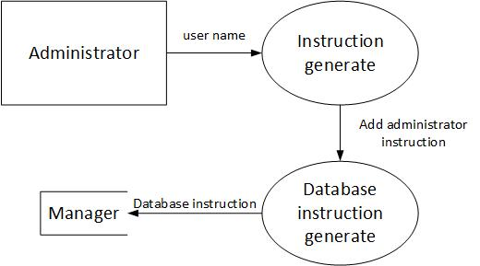
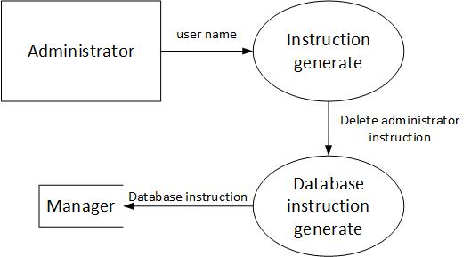
Data Flow - Add and Delete Administer

Slide 24
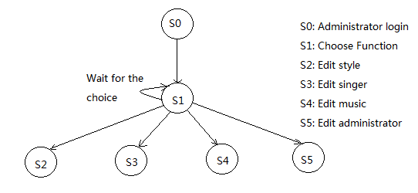
State Transfer - Admin

Slide 25
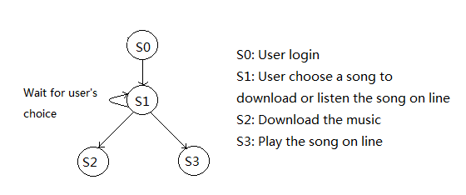
State Transfer - User

Slide 26
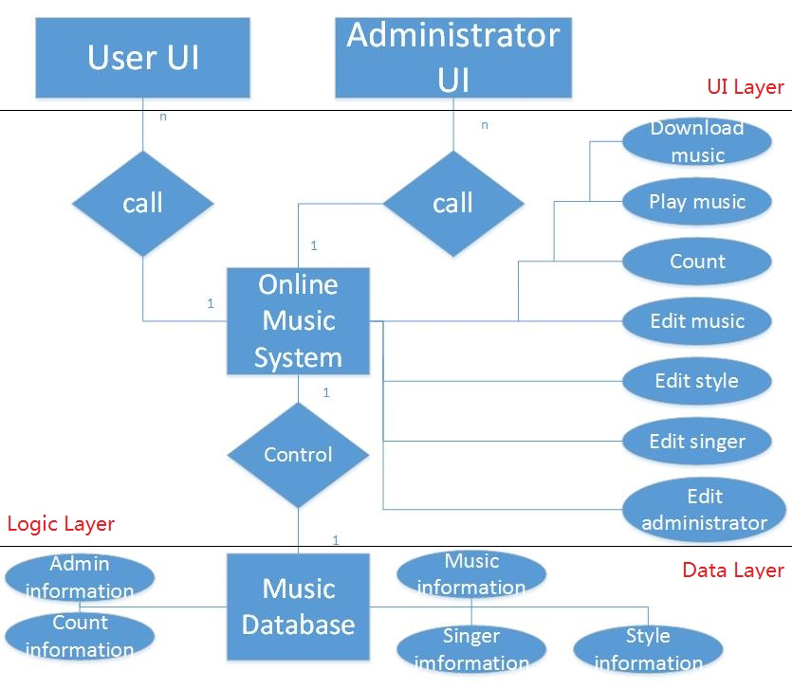
Feature Relationship

Slide 27
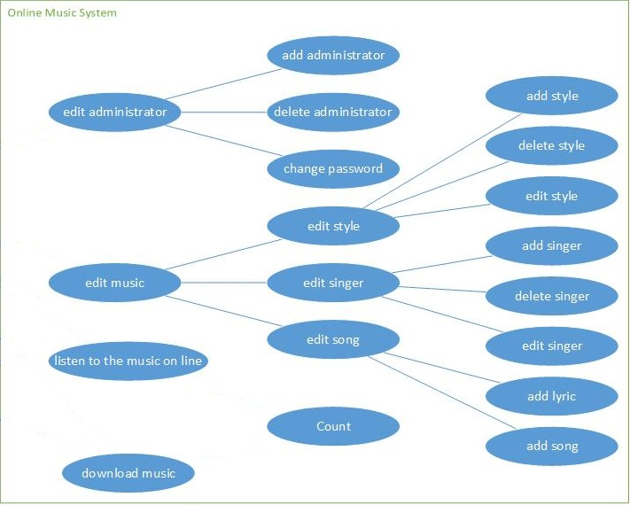

Slide 28

Implementation

Slide 29
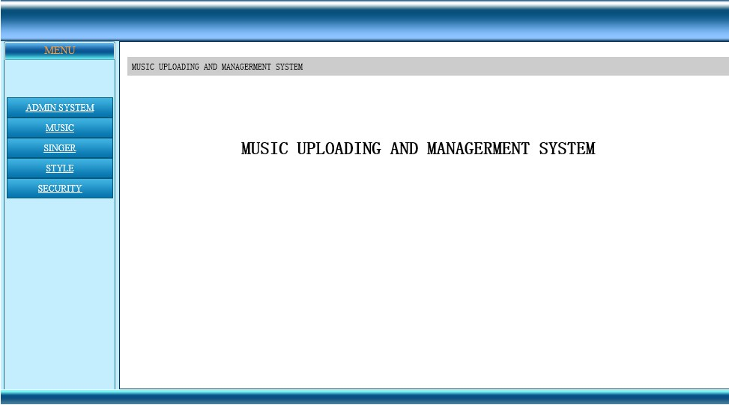
Admin Page

Slide 30
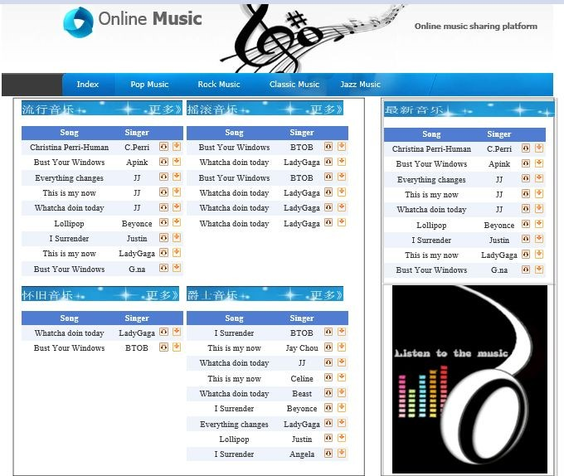
System Home Page

Slide 31
On-site Demo

Slide 32

Q & A

